Slide 1
Accounting?
The Language of Business

Slide 2
PollEverywhere
What do you already know about accounting?

Slide 3
Notes:
Video: https://www.youtube.com/watch?v=sCH7u1xHsX0

Slide 4
What is Business?
The exchange of
GOODS
Think: lettuce, Ferraris, Converse
or
SERVICES
Think: housekeeping, Skydiving, Escape Rooming
For
$$$$$ (aka profit)

Slide 5
So…What is Accounting?
A mathematical and organizational
SYSTEM
that provides financial information
used to make
DECISIONS
about the future of a
BUSINESS

Slide 6
So…What is an Accountant?
Someone who records (bookkeeping), controls, analyzes and
INTERPRETS
the information in an accounting system.
Then uses this information to make
DECISIONS
about a business and how it operates

Slide 7
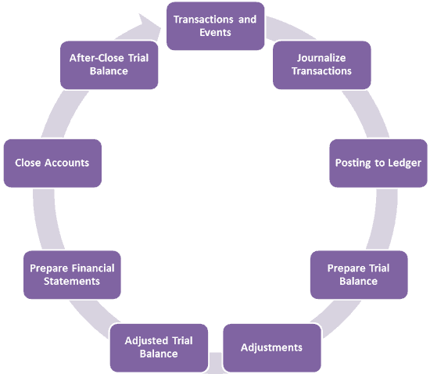
K, Yeah But… WHAT do we actually do in Accounting class?
The
Accounting
Cycle!

Slide 8
Financial Statements?
Informal | Formal
Journal A chronological record of transactions | Balance Sheet Statement of financial position that lists assets, liabilities, and OE at a specific date
Ledger Group of accounts that contain a numerical record of incoming and outgoing accounts | Income Statement Summarizes revenue and expenses to determine profit or loss
Trial Balance A list of all account balances that seeks to determine the mathematical accuracy of a ledger
Once the mathematical accuracy of the informal statements have been proven, formal
statements are prepared for “outside users”
(banks, investors or the government)

Slide 9
Feeling Overwhelmed?
Stop it.
You don’t need to understand or remember the things on the previous slide… not, yet anyways.
We will go over each concept in detail. We will take baby steps.
And accounting really isn’t that difficult.
Trust me.

Slide 10
Feeling Bored?
I don’t blame you.
Accounting will never be exciting in the way that skydiving, driving a Ferrari, or wearing your brand new Converse shoes for the first time will be.
But it’s kinda fun… in a sensible, logic-based, problem-solving-y sort of way.
Trust me.

Slide 11
Feeling Like You Don’t Know Why You’re Here?
Well, allow me to explain.
Accounting is practical. You will use it – even if you don’t see accounting as part of your future career.

Slide 12
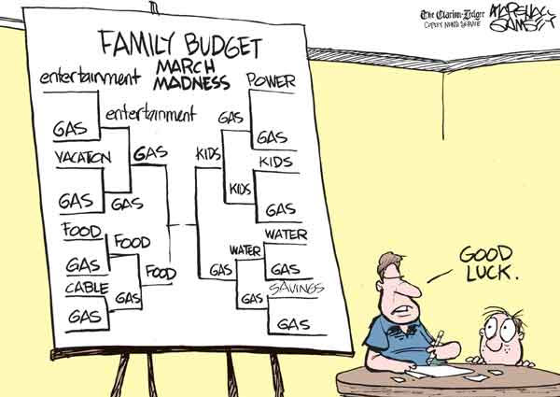
Feeling Like You Don’t Know Why You’re Here?
Well, allow me to explain.
You will use it in your personal life.

Slide 13
Feeling Like You Don’t Know Why You’re Here?
Well, allow me to explain.
You may use it in your professional life.
I couldn’t find any fun cartoons for this one. Accounting isn’t really all that funny…
BUT
It is profitable.

Slide 14
$$$$$$$$
Accountants earn between
$35 000 - $125 000
per year
The median income is
$60 000
per year
BUT a Chief Financial Officer can earn up to
$240 000
per year
Notes:
https://www2.careercruising.com/careers/earnings/85
http://www.payscale.com/research/CA/Job=Chief_Financial_Officer_(CFO)/Salary

Slide 15
Accounting Careers
An accountant is responsible for helping with all sorts of logic and numbers-based tasks, including preparing financial documents, making budgets and filing taxes.
There are SO levels of accountants:
MBA (Masters in Business Degree)
CPA (Chartered Professional Accountant)
Managerial Accountant (Manager)
CFO (Chief Financial Officer)
Notes:
https://www2.careercruising.com/careers/earnings/85
http://www.payscale.com/research/CA/Job=Chief_Financial_Officer_(CFO)/Salary

Slide 16
Accounting Careers
An accountant is responsible for helping with all sorts of logic and numbers-based tasks, including preparing financial documents, making budgets and filing taxes.
There are SO many types of accountants:
Government Accountants
Public Accountants
Business Accountants
Forensic Accountants
Notes:
https://www2.careercruising.com/careers/earnings/85
http://www.payscale.com/research/CA/Job=Chief_Financial_Officer_(CFO)/Salary

Slide 17
Accounting Careers
An accountant is responsible for helping with all sorts of logic and numbers-based tasks, including preparing financial documents, making budgets and filing taxes.
There are SO many RELATED careers:
Actuary
Auditor
Bookkeeper
Economist
Investment Banker
Loans Clerk
Notes:
https://www2.careercruising.com/careers/earnings/85
http://www.payscale.com/research/CA/Job=Chief_Financial_Officer_(CFO)/Salary

Slide 18
The Basics
Anyways, you can’t grab ahold of any of these fancy careers if you don’t even know the basics.
So let’s get to it.
Notes:
https://www2.careercruising.com/careers/earnings/85
http://www.payscale.com/research/CA/Job=Chief_Financial_Officer_(CFO)/Salary

Slide 19
Two Content Layout with SmartArt
First bullet point here
Second bullet point here
Third bullet point here
Step 1 Title
Step 2 Title
Step 3 Title
Step 4 Title

Slide 25
Title and Content Layout with Table
First bullet point here
Second bullet point here
Third bullet point here
 | Group 1 | Group 2
Class 1 | 82 | 95
Class 2 | 76 | 88
Class 3 | 84 | 90

Slide 26
Title and Content Layout with Chart

