Slide 1
Basic
Picture Composition
Part 1

Slide 2
Framing
Definition:
Using other elements within your scene to draw attention to the main subject.
Framing brings more depth and sophistication to a picture and creates a clear focal point.
Example:
Notice how the preacher is holding the Bible in such a way that his arms and the Bible frame his face. This creates a frame that emphasizes his face.
Notes:
What is the subject? How do you know?
What is acting as the frame?

Slide 3
Framing
Definition:
Using other elements within your scene to draw attention to the main subject. Framing brings more depth and sophistication to a picture and creates a clear focal point.
Example:
Notice how, in this beach scene, the boats are framed by the palm tree at the top and left and by the sand at the bottom. Branches of trees often make very effective frames for pictures.
Notes:
What is the subject? How do you know?
What is acting as the frame?

Slide 4
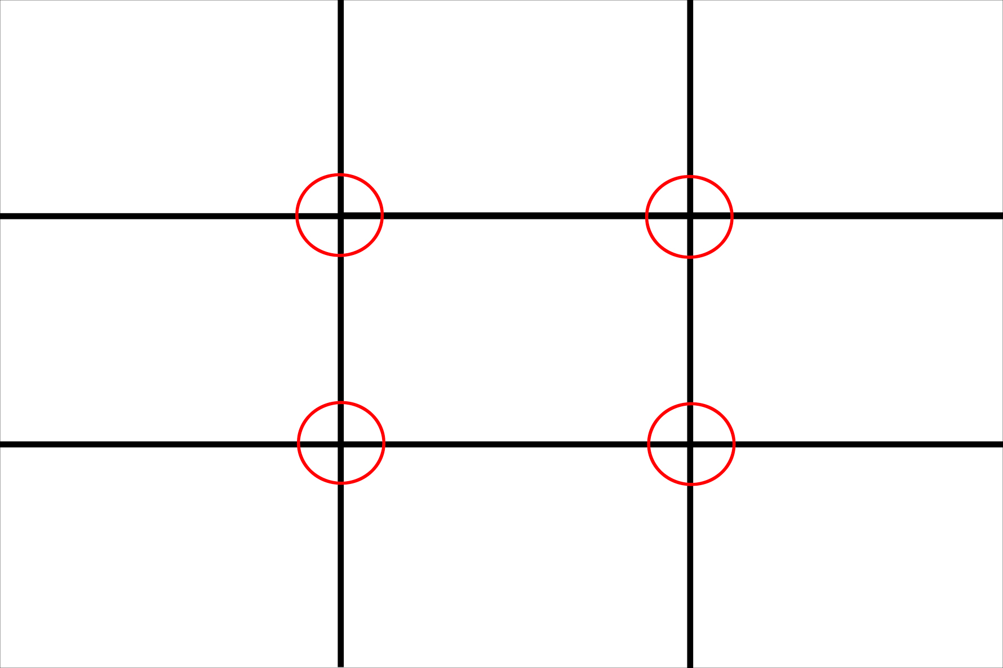
Rule of thirds
Definition:
A picture with the subject placed slightly off-center is, typically, more interesting to a viewer. The Rule of Thirds requires the photographer to break a picture down into 9 parts (2 horizontal lines & 2 vertical lines), and to align the subject with 1 of the 4 cross-sections.
Example:
Notice how, in this scene, the tower is off-center, towards the right-hand side of the scene. In terms of the “Rule of Thirds,” the subject would be located in the top-right cross-section.
Notes:
This is all done in your head, not right on the photograph.
Still symmetrical, yet more intriguing because it is unexpected
What is the subject? How do you know?
Do you agree that placing the subject off to one side makes each picture more attractive?

Slide 5
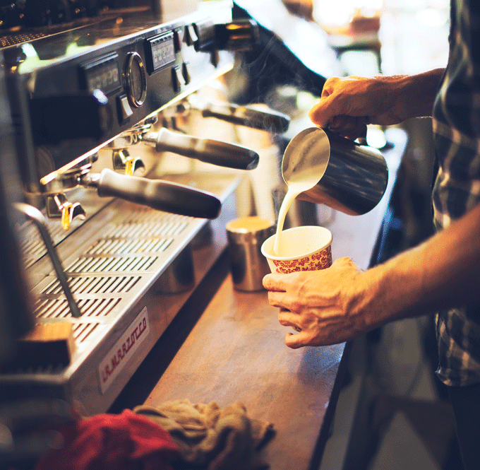
Rule of thirds
Definition:
A picture with the subject placed slightly off-center is, typically, more interesting to a viewer. The Rule of Thirds requires the photographer to break a picture down into 9 parts (2 horizontal lines & 2 vertical lines), and to align the subject with 1 of the 4 cross-sections.
Example:
Notice how, in this scene, the jug and the hand/cup are off-center, towards the right-hand side of the scene. In terms of the “Rule of Thirds,” the subjects would be located in the top-right and bottom-right cross-sections.
Notes:
This is all done in your head, not right on the photograph.
Still symmetrical, yet more intriguing because it is unexpected
What is the subject? How do you know?
Do you agree that placing the subject off to one side makes each picture more attractive?

Slide 6
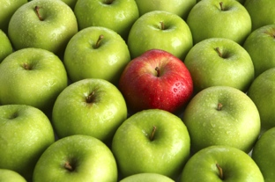
FOCAL point
Definition:
The place the viewer’s eye is drawn first – i.e the main subject, or most important part of the photograph. A clear focal point = a clear message.
Focal point can be communicated in several different ways: framing, rule of thirds, colour, focus, size, etc.
Example:
Notice how, in this scene, the vibrant colour of the red apple, compared to the unified green of the other apples, is used to create a focal point.
Notes:
What is the subject? How do you know?

Slide 7
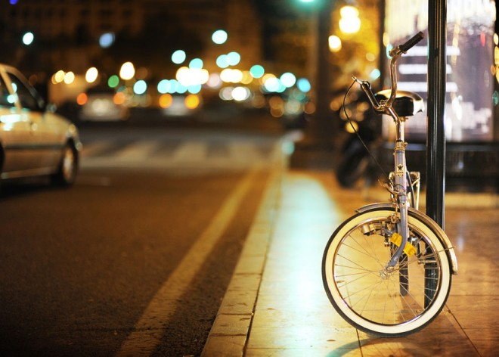
FOCAL point
Definition:
The place the viewer’s eye is drawn first – i.e the main subject, or most important part of the photograph. A clear focal point = a clear message.
Focal point can be communicated in several different ways: framing, rule of thirds, colour, focus, size, etc.
Example:
Notice how, in this scene, the focus of the bicycle, compared to the blur of the background, is used to create a focal point.
Notes:
What is the subject? How do you know?

Slide 8
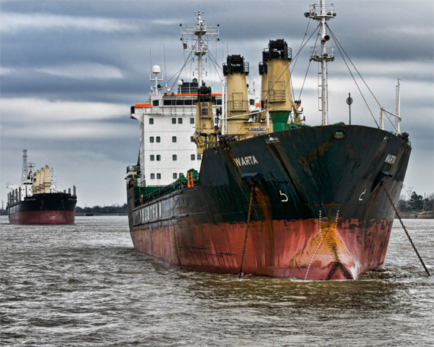
FOCAL point
Definition:
The place the viewer’s eye is drawn first – i.e the main subject, or most important part of the photograph. A clear focal point = a clear message.
Focal point can be communicated in several different ways: framing, rule of thirds, colour, focus, size, etc.
Example:
Notice how, in this scene, the size of the larger ship, compared to the size of the smaller ship is used to create a focal point.
Notes:
What is the subject? How do you know?
Which of the 5 focal point techniques discussed, so far, do you think is most effective?

Slide 9
Unusual angles
Definition:
Photographing a subject from an angle other than head-on. Using an unusual angle adds interest to your photograph, since it allows your viewer to experience your subject in a different way.
Some examples include low angles, high angles, birds-eye views, or tilts.
Example:
Notice how, in this scene, the tulips are photographed from an extremely low angle, making it seem as though the viewer is growing up with the flowers.
Notes:
What type of angle is used here?
What kind of effect does it have on the viewer?

Slide 10
Unusual angles
Definition:
Photographing a subject from an angle other than head-on. Using an unusual angle adds interest to your photograph, since it allows your viewer to experience your subject in a different way.
Some examples include low angles, high angles, birds-eye views, or tilts.
Example:
Notice how, in this scene, the old cross is photographed from a low angle, creating a feeling of reverence, awe, and submission in the viewer.
Notes:
What type of angle is used here?
What kind of effect does it have on the viewer?

Slide 11
Line
Definition:
Lines are used to lead your viewer’s eye towards your focal point, create balance and symmetry, and to grab the viewer’s attention by boldening a picture’s look.
Hard, strong lines usually communicate rigidness, sophistication, precision, etc., while soft, curved lines usually communicate calm, playfulness, freedom etc.
Example:
Notice how, in this scene, the lines in the freshly mowed grass create symmetry, and grab the viewer’s attention. The lines are sharp and straight, indicating precision, masculinity, and balance.
Notes:
What type of angle is used here?
What kind of effect does it have on the viewer?

Slide 12
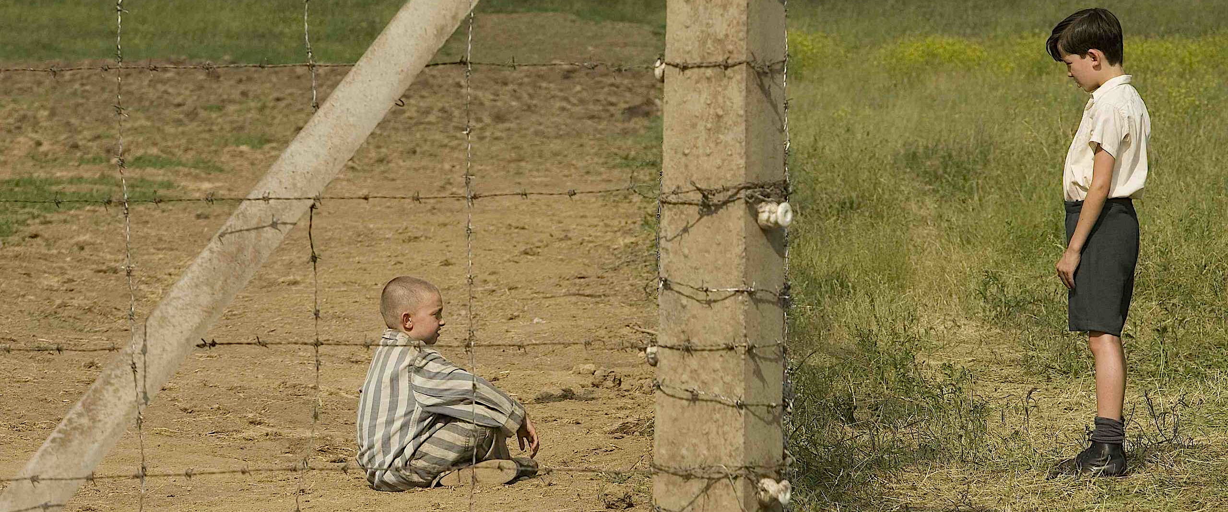
Line
Definition:
Lines are used to lead your viewer’s eye towards your focal point, create balance and symmetry, divide parts of a scene, and to grab the viewer’s attention by boldening a picture’s look.
Hard, strong lines usually communicate rigidness, sophistication, precision, etc., while soft, curved lines usually communicate calm, playfulness, freedom etc.
Example:
Notice how, in this scene, lines are used to communicate a vast amount of information about the two subjects contained in it, including their circumstances.
Notes:
What type of angle is used here?
What kind of effect does it have on the viewer?

Slide 13
Active space
Definition:
Leaving empty, space beside your subject, creating the illusion that your subject will “move into” this space. Placing a subject off-center, then leaving space in the direction this subject is facing leads your viewer’s eye towards the space, and causes him/her to understand and anticipate where the subject is intending to “move”
Example:
Notice how, in this scene, the pose is made more recognizable as MOVEMENT, since there is a space in the photo towards which the subject is moving.
Notes:
What is the subject of this photo?
Is the subject moving? Where to?

Slide 14
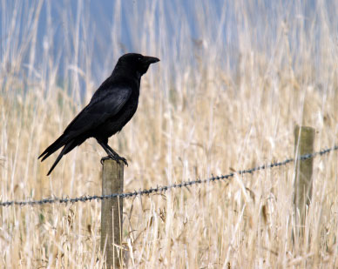
Active space
Definition:
Leaving empty, space beside your subject, creating the illusion that your subject will “move into” this space. Placing a subject off-center, then leaving space in the direction this subject is facing leads your viewer’s eye towards the space, and causes him/her to understand and anticipate where the subject is intending to “move”
Example:
Notice how, in this scene, the viewer is made to anticipate that the crow will MOVE, rather than remain stationary, since it is facing an empty space.
Notes:
What is the subject of this photo?
Is the subject moving? How does the photograph communicate that?
If there was no blank space, would it be as easy to tell that the crow planned on moving?

