Slide 1
Basic Picture Composition
Part 2

Slide 2
Defined subject
Definition:
A good picture should have a clearly defined and recognizable subject. There may be more than one subject in a photo but, typically, one subject, or one group of subjects takes precedence over the others!
Example:
Notice how the photographer took care to focus in on one clear subject. Even though there is a tree, sand, and water, it is clear that the subject is the girl sitting atop the crocodile, since they are the largest objects and are properly aligned.
Notes:
What is the subject? How do you know?
What did the photographer do to show you what the defined subject is?
What photography technique is being used?

Slide 3
defined
or not?
Definition:
A good picture should have a clearly defined and recognizable subject. There may be more than one subject in a photo but, typically, one subject, or one group of subjects takes precedence over the others!
Good Example:
Notice how the photographer focused in on the leaves in this photograph so that they appeared to stand out against the blurred green background. This way, it is clear to the viewer that the leaves are the subject.
Notes:
What is the subject? How do you know?
What did the photographer do to show you what the defined subject is?
What photography technique is being used?

Slide 4
Defined or ?
not
Definition:
A good picture should have a clearly defined and recognizable subject. There may be more than one subject in a photo but, typically, one subject, or one group of subjects takes precedence over the others!
Bad Example:
There are several different objects within this photograph that are competing for the role of “main subject.” All the objects are located in the same level, are evenly spaced, are the same size, and are of the same colour value. There is no object that stands out more than another.
Notes:
What is the subject? How do you know?
What did the photographer do to show you what the defined subject is?
What photography technique is being used?

Slide 5
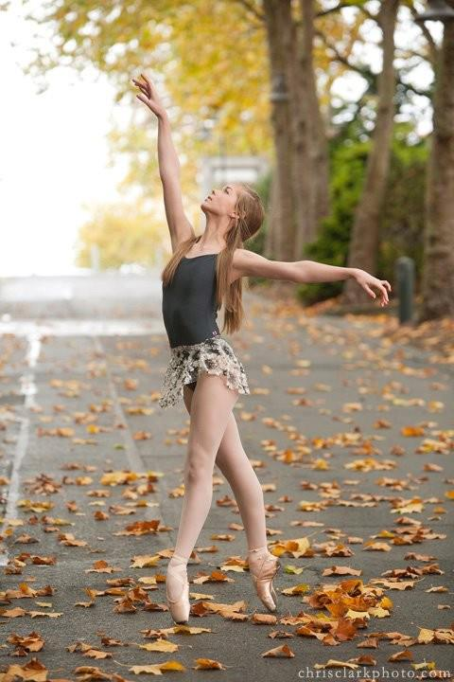
Understated Background
Definition:
A good background should support your subject, but not overpower it. It should be simple to tell what the subject is upon first glance, and the colours, objects, and lines contained within the background should help tell the subject’s story, rather than overwhelm the viewer.
Example:
Though there are some elements in the background (the road, leaves, and trees) to add interest to the photo, none of these elements take away from the subject.
Notes:
A good test is to show someone your picture, allow them to study it for a few seconds, and then take the picture away. If he/she can easily remember what was in the background, then the background is probably too powerful. If they can clearly remember the subject but can’t remember the background then your background probably is a good one.

Slide 6
Understated or ?
not
Definition:
A good background should support your subject, but not overpower it. It should be simple to tell what the subject is upon first glance, and the colours, objects, and lines contained within the background should help tell the subject’s story, rather than overwhelm the viewer.
Bad Example:
Though there are some elements in the background (the road, leaves, and trees) to add interest to the photo, none of these elements take away from the subject.
Notes:
A good test is to show someone your picture, allow them to study it for a few seconds, and then take the picture away. If he/she can easily remember what was in the background, then the background is probably too powerful. If they can clearly remember the subject but can’t remember the background then your background probably is a good one.

Slide 7
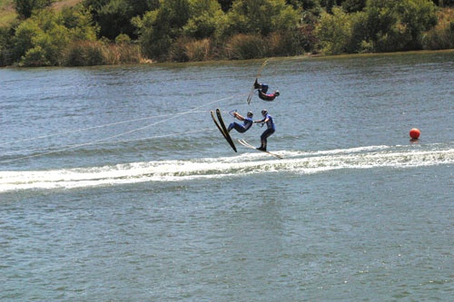
Understated
Or not?
Definition:
A good background should support your subject, but not overpower it. It should be simple to tell what the subject is upon first glance, and the colours, objects, and lines contained within the background should help tell the subject’s story, rather than overwhelm the viewer.
Good Example
Though there are some elements in the background (the road, leaves, and trees) to add interest to the photo, none of these elements take away from the subject.
Notes:
A good test is to show someone your picture, allow them to study it for a few seconds, and then take the picture away. If he/she can easily remember what was in the background, then the background is probably too powerful. If they can clearly remember the subject but can’t remember the background then your background probably is a good one.

Slide 8
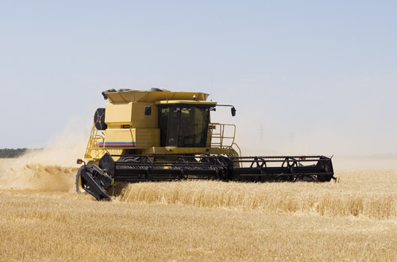
natural exposure
Definition:
Exposure refers to how much light is present in the photograph. Typically, a photo should mirror the brightness of its real-life subject.
“Over-exposure” describes a photo that is too bright.
“Under-exposure” describes a photo that is too dark.
Example:
The photographer made sure to take this photo at the correct time of day, using the right lighting settings on his/her cameras.
Notes:
Some factors that affect the exposure of a photograph are:
Time of Day
Location
Camera Flash
Aperture
Shutter Speed
ISO

Slide 9
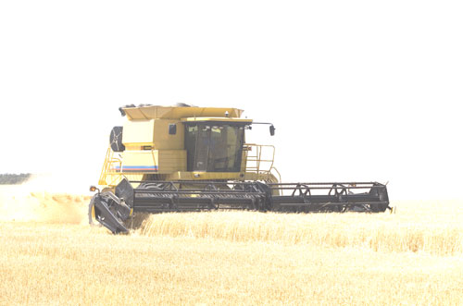
Over
or Under-exposure?
Definition:
Exposure refers to how much light is present in the photograph. Typically, a photo should mirror the brightness of its real-life subject.
“Over-exposure” describes a photo that is too bright.
“Under-exposure” describes a photo that is too dark.
Overexposure:
The subject is recognizable, but the lighting is unnaturally bright, which means that too much light entered the camera as the picture was taken.
Notes:
Some factors that affect the exposure of a photograph are:
Time of Day
Location
Camera Flash
Aperture
Shutter Speed
ISO

Slide 10
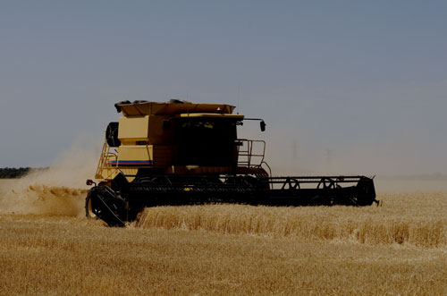
Over or
Under exposed?
Definition:
Exposure refers to how much light is present in the photograph. Typically, a photo should mirror the brightness of its real-life subject.
“Over-exposure” describes a photo that is too bright.
“Under-exposure” describes a photo that is too dark.
Underexposure
The subject is recognizable, but the lighting is unnaturally dark, which means that not enough light entered the camera as the picture was taken.
Notes:
Some factors that affect the exposure of a photograph are:
Time of Day
Location
Camera Flash
Aperture
Shutter Speed
ISO

Slide 11
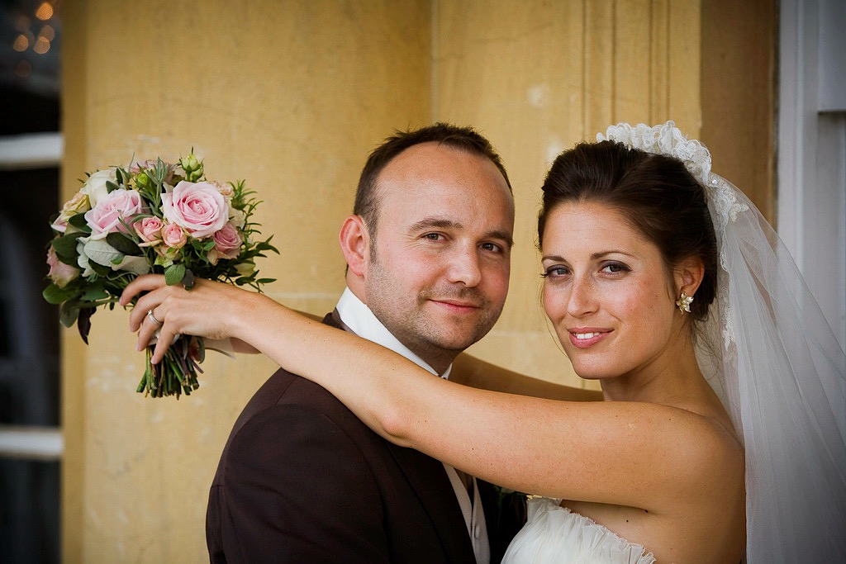
SHARP FOCUS
Definition:
Your photograph’s contents or, at least, your photo’s subject, should be in sharp focus, meaning that they are crisp and clear. Pictures can be out of focus as a result of moving the camera while taking the photo, or by using incorrect camera settings.
Example:
In this photograph, the outline of each part of the gazebo, trees, snow, and shadows are crisp, clean, and clear, allowing the viewer a clear idea of the photo’s contents.
Notes:
What is the subject? How do you know?
What did the photographer do to show you what the defined subject is?
What photography technique is being used?

Slide 12
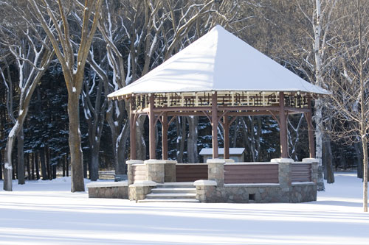
SHARP
or not?
Definition:
Your photograph’s contents or, at least, your photo’s subject, should be in sharp focus, meaning that they are crisp and clear. Pictures can be out of focus as a result of moving the camera while taking the photo, or by using incorrect camera settings.
Good Example:
In this photograph, the outline of each part of the gazebo, trees, snow, and shadows are crisp, clean, and clear, allowing the viewer a clear idea of the photo’s contents.
Notes:
What is the subject? How do you know?
What did the photographer do to show you what the defined subject is?
What photography technique is being used?

Slide 13
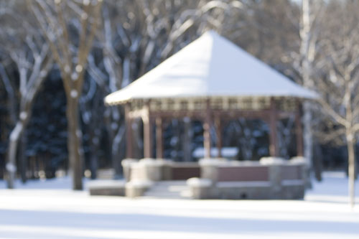
SHARP
or not?
Definition:
Your photograph’s contents or, at least, your photo’s subject, should be in sharp focus, meaning that they are crisp and clear. Pictures can be out of focus as a result of moving the camera while taking the photo, or by using incorrect camera settings.
Bad Example
In this photograph, the outline of each part of the gazebo, trees, snow, and shadows is faded and blurry, preventing the viewer from getting a clear idea of the photo’s contents.
Notes:
What is the subject? How do you know?
What did the photographer do to show you what the defined subject is?
What photography technique is being used?

Slide 14
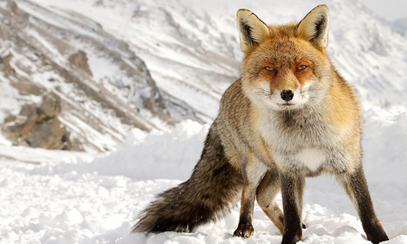
Fill the Frame
Definition:
Many photos are more attractive if the subject is large and clearly visible. If the majority of the frame is filled with the subject, it is much easier to focus in on its details, rather than get lost in unnecessary and, often, repetitive background space.
Example:
Notice how the photographer framed the fox from head to toe, rather than include excess background and foreground snow and mountains. There is just enough background to balance the photo, add a touch of context, and keep the 16:9 ratio.

Slide 15
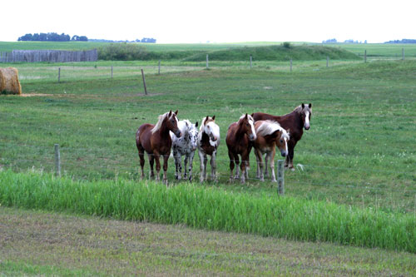
Filled
or not?
Definition:
Many photos are more attractive if the subject is large and clearly visible. If the majority of the frame is filled with the subject, it is much easier to focus in on its details, rather than get lost in unnecessary and, often, repetitive background space.
Bad Example
In this photograph, there is a lot of unnecessary background and foreground (grass) surrounding the subject. Such a large amount of grass is not needed to establish setting, so it would be better to dedicate more space to the subject.

Slide 16
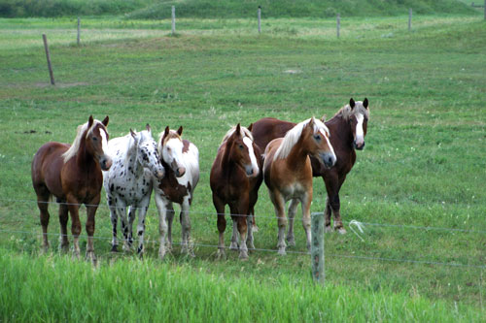
Filled
or not?
Definition:
Many photos are more attractive if the subject is large and clearly visible. If the majority of the frame is filled with the subject, it is much easier to focus in on its details, rather than get lost in unnecessary and, often, repetitive background space.
Good Example
In this photograph, more of the frame is dedicated to the subject (the horses). There is just enough grass in the foreground and background to establish the setting and frame the horses.

Slide 17
EVEN level
Definition:
The lines in your photograph should be straight (unless you are purposely using uneven lines to communicate a message), since symmetry is more visually appealing to the human eye, and it creates a more realistic representation of the photograph’s content.
Example:
This photograph is naturally divided into 3 different layers, all of which create 2 even horizon lines when they meet (sky-sea, sea-sand)
Notes:
Oftentimes, the photographer is so focused on his/her subject that he/she forgets to pay attention to the evenness of the horizon line.

Slide 18
EVEN
or not?
Definition:
The lines in your photograph should be straight (unless you are purposely using uneven lines to communicate a message), since symmetry is more visually appealing to the human eye, and it creates a more realistic representation of the photograph’s content.
Bad Example
In this photograph, the horizon line where the trees meet the water is crooked, as is the water skiers’ path of motion.

Slide 19
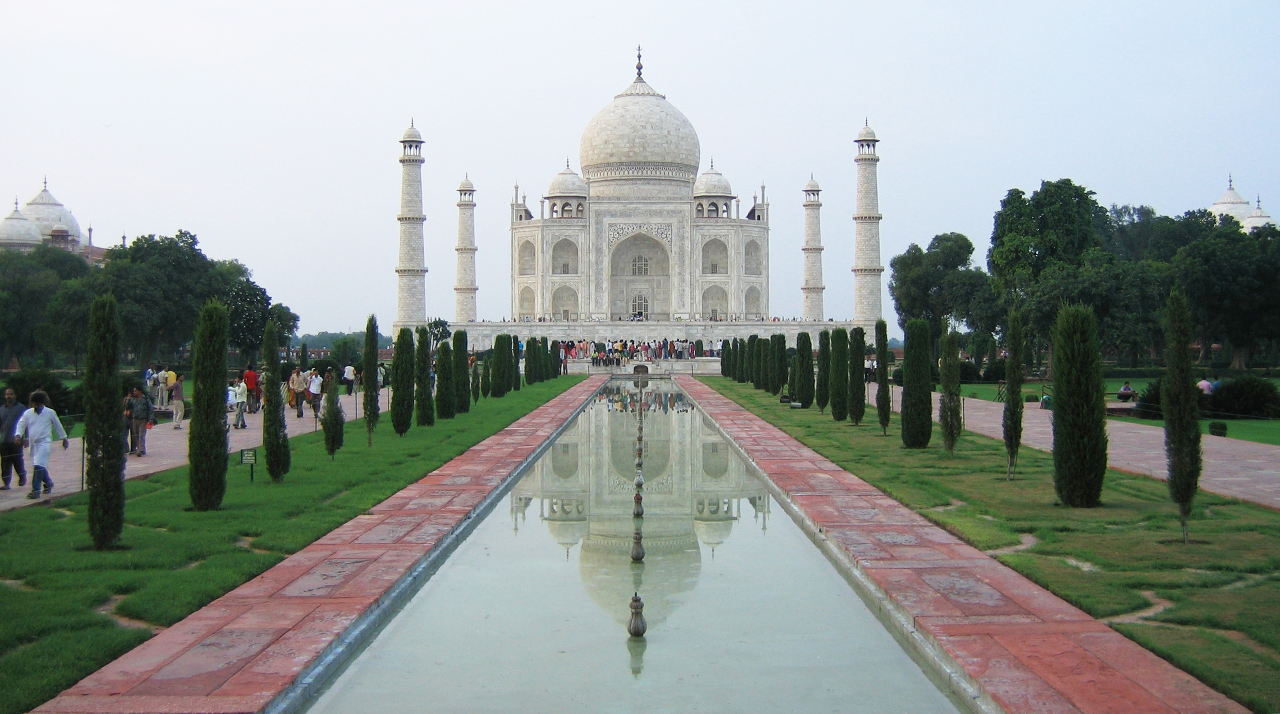
EVEN
or not?
Definition:
The lines in your photograph should be straight (unless you are purposely using uneven lines to communicate a message), since symmetry is more visually appealing to the human eye, and it creates a more realistic representation of the photograph’s content.
Good Example
In this photograph, the Taj Mahal’s uppermost and lowermost points are even with the horizon line. It also demonstrates great symmetry in almost every other aspect.
Notes:
What is symmetry? In what ways does this photo demonstrate good symmetry?

Slide 20
SYMMETRY?
What are
your thoughts
on
this photo?

