Slide 1
Defined subject
Definition:
A good picture should have a clearly defined and recognizable subject. There may be more than one subject in a photo but, typically, one subject, or one group of subjects takes precedence over the others!
Example:
Notice how the photographer took care to focus in on one clear subject. Even though there is a tree, sand, and water, it is clear that the subject is the girl sitting atop the crocodile, since they are the largest objects and are properly aligned.
Notes:
What is the subject? How do you know?
What did the photographer do to show you what the defined subject is?
What photography technique is being used?

Slide 2
Understated Background
Definition:
A good background should support your subject, but not overpower it. It should be simple to tell what the subject is upon first glance, and the colours, objects, and lines contained within the background should help tell the subject’s story, rather than overwhelm the viewer.
Example:
Though there are some elements in the background (the road, leaves, and trees) to add interest to the photo, none of these elements take away from the subject.
Notes:
A good test is to show someone your picture, allow them to study it for a few seconds, and then take the picture away. If he/she can easily remember what was in the background, then the background is probably too powerful. If they can clearly remember the subject but can’t remember the background then your background probably is a good one.

Slide 3
natural exposure
Definition:
Exposure refers to how much light is present in the photograph. Typically, a photo should mirror the brightness of its real-life subject.
“Over-exposure” describes a photo that is too bright.
“Under-exposure” describes a photo that is too dark.
Example:
The photographer made sure to take this photo at the correct time of day, using the right lighting settings on his/her cameras.
Notes:
Some factors that affect the exposure of a photograph are:
Time of Day
Location
Camera Flash
Aperture
Shutter Speed
ISO

Slide 4
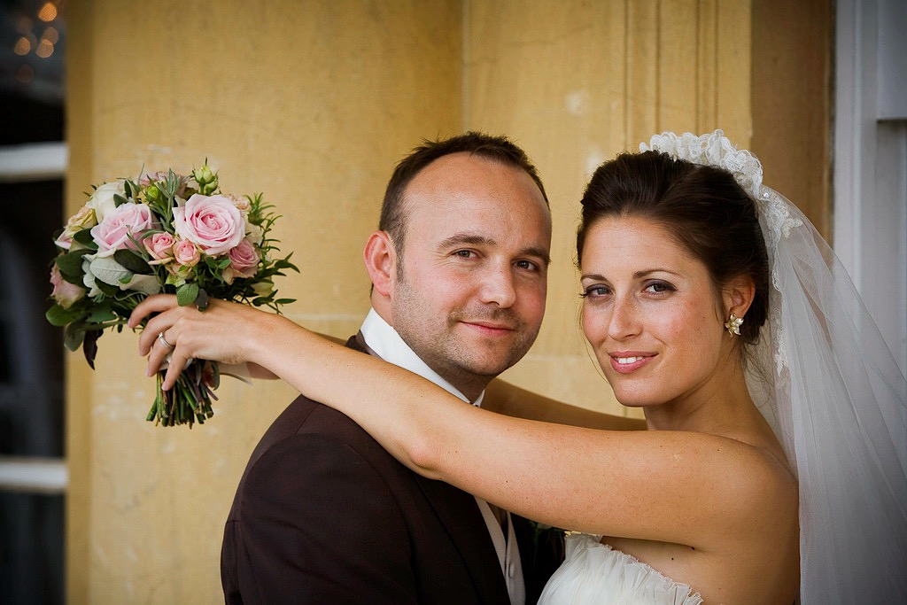
SHARP FOCUS
Definition:
Your photograph’s contents or, at least, your photo’s subject, should be in sharp focus, meaning that they are crisp and clear. Pictures can be out of focus as a result of moving the camera while taking the photo, or by using incorrect camera settings.
Example:
In this photograph, the outline of each part of the gazebo, trees, snow, and shadows are crisp, clean, and clear, allowing the viewer a clear idea of the photo’s contents.
Notes:
What is the subject? How do you know?
What did the photographer do to show you what the defined subject is?
What photography technique is being used?

Slide 5
Fill the Frame
Definition:
Many photos are more attractive if the subject is large and clearly visible. If the majority of the frame is filled with the subject, it is much easier to focus in on its details, rather than get lost in unnecessary and, often, repetitive background space.
Example:
Notice how the photographer framed the fox from head to toe, rather than include excess background and foreground snow and mountains. There is just enough background to balance the photo, add a touch of context, and keep the 16:9 ratio.

Slide 6
EVEN level
Definition:
The lines in your photograph should be straight (unless you are purposely using uneven lines to communicate a message), since symmetry is more visually appealing to the human eye, and it creates a more realistic representation of the photograph’s content.
Example:
This photograph is naturally divided into 3 different layers, all of which create 2 even horizon lines when they meet (sky-sea, sea-sand)
Notes:
Oftentimes, the photographer is so focused on his/her subject that he/she forgets to pay attention to the evenness of the horizon line.

