Slide 1
HOW TO Write, Format, & Organize a Scholarly Essay
(A really long and rambling tutorial to help you through high school)

Slide 2
The Writing Variables: A Brief Review
Audience (age, gender, interests)
Purpose (to entertain, to persuade, to inform)
Form (article, story, essay)
Central Idea (theme, focus, thesis)
Context (situation in which audience will experience the text)

Slide 3
The #1 Mistake Rookie Writers Make: NOT ANWERING THE QUESTION!
Make sure your thesis, and everything within your essay responds directly to the question you are trying to answer! Do not simply summarize events from the story – use these events as examples to support your answer.
Also, unless the question asks for your personal opinion, DO NOT give it. Use only factual information.

Slide 4
1. Essay Organization
Basically, your essay must contain 3 general parts:
Introduction – General information and thesis statement
Body – Paragraphs containing evidence to support your thesis
Conclusion – Reinstatement of thesis, and summary of arguments

Slide 5
Introduction
The introduction also contains 3 parts:
The Fetching First Line
The In-Between
The Thesis Statement
Note: Somewhere within these 3 parts, you must state 1) the title of the book(s) you are studying, and
2) the author(s)’ name(s)

Slide 6
The Fetching First Line: Reveals the essay’s topic and engages (aka “hooks”) the reader
A fetching first line should be thought-provoking, informative, interesting, dramatic, or eye-opening in order to capture the reader’s attention

Slide 7
An Example of a Fetching First Line: Cheese is one of the world’s oldest foods, originating long before human history was ever recorded.

Slide 8
The In-Between: Provides general background information on your chosen topic, and describes why you are writing about it (why it is important)!

Slide 9
An Example of The In-Between:
Cheese is one of the world’s oldest foods, originating long before human history was ever recorded. Though cheese is presently enjoyed in all parts of the world, the ancient Greeks have been credited with its invention. Though some people find its formation to be somewhat offensive, and its odour to be down-right appalling, cheese is one of the most common, and quite frankly, the most awesome foods on the planet Earth.

Slide 10
The Thesis Statement: Can, technically, be anywhere within the introduction BUT
it is usually most effective at the end!
Consists of 2 parts:
1) The Main Idea (your topic, and what you are going to do with it)
2) The Roadmap (the specific evidence/sub-ideas that support your Main Idea)

Slide 11
An Example of a Thesis Statement:

Slide 12
Tips for Writing a Thesis:
Ask yourself “how,” and “why” questions to develop a solid and rich thesis
Respond to the question in your own words; don’t simply rewrite it in sentence form (take your own stance and direction)
The more detailed the thesis, the better – HOWEVER, make sure that you can sufficiently explore and develop each portion of your thesis

Slide 13
BODY PARAGRAPHS
The body of an essay consists of a series of paragraphs, each of which contains a specific piece of evidence/sub-idea that supports the Thesis (main idea)
A standard high school essay (2-3 pages) consists of about 3 body paragraphs (5 including the introduction and conclusion).
BUT
A paragraph SHOULD NOT be longer than ¾ of a page SO it is often necessary to increase the amount of paragraphs, depending on the amount of ideas you have ☺

Slide 14
Each paragraph must contain 3 major parts:
Topic Sentence: A mini-thesis (containing a point from your roadmap) for each paragraph; found at the paragraph’s beginning
SEXY
Content: Evidence (aka an example) to support your thesis including at least 1 quotation, the quotation’s explanation, and how the quotation supports your thesis.
SEXY
Reference to Thesis: How the chosen topic (point from roadmap) supports the thesis!
SEXY

Slide 15
All information contained within the paragraph should respond to the topic sentence, just as each paragraph in the body responds to the thesis!

Slide 16
CONCLUSION
The conclusion contains, you guessed it, 3 parts:
Restatement of Thesis: Repetition of the thesis using different words than in the introduction (but, whyyyyy? To remind your reader of your thesis after reading)
Summary of Each Piece of Evidence/Sub-Idea: Repetition of your roadmap using different words than in the introduction
Concluding Statement: Justification of why your topic matters, and/or how essay’s thesis has been proven successful

Slide 17
Make sure that your conclusion only SUMMARIZES information you have already discussed. There should be NO NEW INFORMATION in a conclusion.

Slide 18
2. Essay Outline
Creating a detailed outline prior to writing your essay will help you organize your ideas, which will make your essay much easier for YOU to write, and much easier for YOUR READER to read!
Some examples of how to create an essay outline:
Paragraph Breakdown (each paragraph represented by one sentence)
Web (with thesis in the center)
Index Cards (one topic per card)

Slide 19
Paragraph Breakdown:
Introduction (thesis): Cheese is awesome because it is delicious, nutritious, and it never goes bad.
Paragraph 1: Cheese is delicious
It compliments many other foods since there are a variety of flavors
Example: Cheese whiz goes well on toast, parmesan goes well with pasta, and feta goes nicely on top of scrambled eggs
Paragraph 2: Cheese is nutritious
It contains calcium, with causes growth and prevents osteoporosis
Example: Teenagers require 4 servings of calcium every day in order to keep their bones healthy, while elderly people need up to 5
Paragraph 3: Cheese never goes bad
It is already super old and even if it grows mould, the mouldy part can be cut off
Example: Extra sharp cheese is up two years old before anyone even buys it!
Conclusion: Cheese is one of the tastiest, most resilient, and most nutritious foods available to people all over the world.
Note: For every point you make, you must include evidence to back it up!

Slide 20
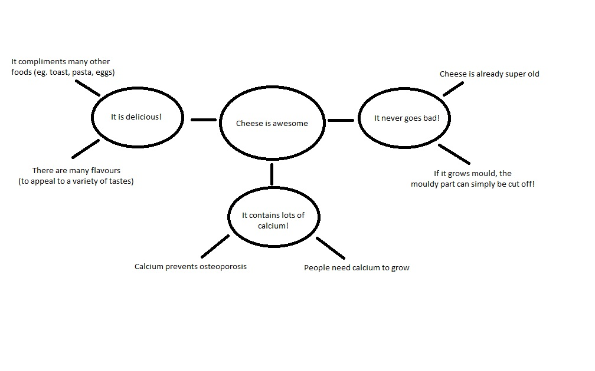
Web Outline

Slide 21
3. Essay Formatting
Integrating Quotes
Finding quotes is not the only thing you need to worry about!
How you integrate, cite, and explain the quotes is just as, if not more, important!

Slide 22
BECAUSE you must EXPLAIN your quotes after you have integrated them, there is NO WAY a quote should EVER appear at the very END of your paragraph!

Slide 23
Paraphrasing When you paraphrase, you take the ideas/information of others and put it into your own words. Since you are not directly quoting, you do not need to use quotation marks. However, you must still give the source credit for their ideas by citing their name and page number.

Slide 24
The LI.QU.ID. Method of Quote Integration: Lead-In: Introduce the quote: identify the quote’s speaker, the quote’s context, and the quote’s location in the text. Quote: Include the quote. Remember, the quote must appear in “quotation marks” and be written EXACTLY as it is found in the text. Investigative Discussion: Never assume a quote explains itself. Ever. After you have included the quote, explain/examine what the quote means, why it means this, and why it is relevant to your thesis. The investigative discussion is what differentiates a weak response from a strong response.

Slide 25
Examples of how to Format Quotes/Paraphrase: According to Mozzart Goudacheez, “cheese is one of the world’s most common foods” (21). Though a select few people find cheese to be appalling “cheese is one of the world’s most common foods” (Goudacheez 21). By no means is cheese a rare item. It is one of the world’s favourite foods (LeFromage 64). When exploring the resiliency of cheese, Brie LeFromage describes Bleu Cheese, in particular: “It is simply never goes bad! I mean, it is blue from the mold already!” (LeFromage 64)

Slide 26
MLA & Quoting
Direct quotes must be surrounded by a set of quotation marks (“”)
The punctuation lies after the quotation marks, and after the in-text citation (unless a question or exclamation mark is used)
Citation is done throughout the text, directly following the quotation
Eg. “Cheese is awesome” (Curdblossom 232).

Slide 27
MLA & Quoting Cont’d
Quotes over 4 lines long are considered “block quotes” and must be formatted differently than regular quotes:
Indent 1 inch (entire quote) by pressing the “tab” button
Do not use quotation marks
Double space (entire quote)
Include the citation in brackets following the quote, as normal

Slide 28
MLA & Quoting Cont’d
If a quotation cannot be integrated smoothly into your text because of its sentence structure, you may use only a portion of the quote as long as you use ellipses (…) to represent the words you’ve omitted.
If a quotation cannot be integrated smoothly into your text due to capitalization, tense, exclusion of important information etc., letters or words may be changed using square brackets (as long as the changes do not alter the context)
Eg. Original quote: “Cheese is awesome”
Eg. Integrated quote: Revered food critic Francis Curdblossom maintains that “[c]heese is awesome.”

Slide 29
Top 5 General Writing Tips
DO NOT use “you” unless directly addressing someone (eg. in a letter)
DO NOT repeat words or ideas consistently throughout your writing
DO NOT use run-on sentences/comma splices
DO NOT use the semicolon incorrectly
DO NOT confuse past and present tense

Slide 30
Top 6 Formal Writing Tips
DO NOT use first person (I, me, we)
DO NOT use slang (gonna, lol, crap)
DO NOT use contractions (it’s, aren’t)
DO NOT write in sentence fragments
DO NOT ramble (write clear, concise sentences – punctuation is your friend)
NEVER refer to people you do not know personally by their first name only (always refer to them by their full or last name)

Slide 31
THE END
(Uggh… finally…)

Slide 32
Everything You Need to Know
About MLA
Font: Times New Roman, size 12
Essay Header (name, teacher’s name, class, date): Top Right Corner, Double Spaced
Last Name & Page Number: Upper Right-Hand Corner
Insert, Page number
Essay Title: Centered, Times New Roman, Size 12
Essay Text: Left-Justified

Slide 33
Everything You Need to Know
About MLA cont’d
Spacing: Double Spaced
Margins: 1-Inch (2.54 cm)
Paragraphs: Indented (press “tab” button once)
Titles of Within Essay:
Large Works (Eg. Book): Italicized
Small Works (Eg. Article): Surrounded by Quotation Marks

Slide 34
Everything You Need to Know About MLA cont’d
Title pages are only used for papers over 5 pages long
SO
Instead of including a title page, place all the necessary information in the top, left-hand corner of the essay
Information that MUST be included:
Your name (first and last)
Your teacher’s name (Ms. Hammond)
The course name (20F ELA)
The date (of submission)

Slide 35
Brittani Hammond
Ms. Cook
10F ELA
April 29, 2013
The Awesomeness of Cheese
Cheese is one of the world’s oldest foods, originating long before human history was ever recorded. Though cheese is presently enjoyed in all parts of the world, the ancient Greeks have been credited with its invention. Though some people find its formation to be somewhat offensive, and its odour to be down-right appalling, cheese is one of the most common, and quite frankly, the most awesome foods on the planet Earth.
“Title Page” Information

Slide 36
Everything You Need to Know
About MLA cont’d
Include a “Work(s) Cited” page! You can use:
Microsoft Word
References → Style (MLA 7th) → Insert Citation (add new source) → Ok → Bibliography → Works Cited
Asher, Jay. Thirteen Reasons Why. New York: Penguin Group, 2007. Print.

