Slide 1
Nigger

Slide 2
Quick - Write
What is your initial reaction to this word?
What do you know about it’s background?
Where do you hear this word in today’s world?
What are some other words that have a similar use?
When, if ever, should these words be used?

Slide 3
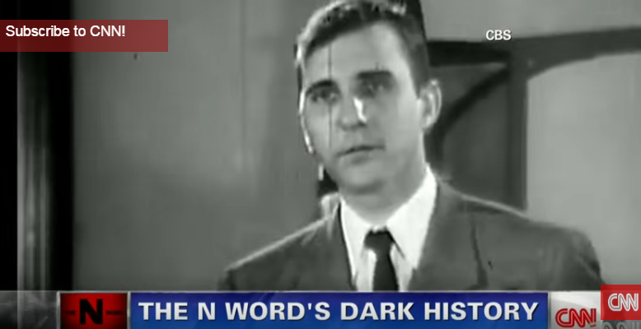
https://www.youtube.com/watch?v=OFnF1c2Tbfw

Slide 4
Niger

Slide 5
1800s

Slide 6
The word was used as a tool to help keep black people “in their place”

Slide 7
The word was used as a tool to help keep black people “in their place”

Slide 8
Jim Crowe Laws – 1890s-1965

Slide 9
KKK 1860s-70s 1920s 1950s-70s and still today

Slide 10
KKK 1860s-70s 1920s 1950s-70s and still today

Slide 11
Religion

Slide 12
Science

Slide 13
Education

Slide 14
Entertainment

