Slide 1
Rhetoric
What is a rhetorical Question, anyways?

Slide 2
The Rhetorical QUestion
A question to which no answer is required
BECAUSE
The answer is obvious or implied

Slide 3
But, What good are they?
They’re used to…
Make or emphasize a point
Make the audience think
Influence agreement from audience

Slide 4
Some Examples:
Is the Pope Catholic/is the grass green/is Beyonce a sexy lady?
Sure, why not?
Are you blind?
How could you?
If your friend jumped off a bridge, would you jump off a bridge, too?
Marriage is a wonderful institution, but who wants to live in an institution?
Could you BE any more annoying?
Must I argue the wrongfulness of slavery?
How long will we look the other way while children suffer?

Slide 5
Rhetoric
Yep… Kape… But what is rhetoric?

Slide 6
Rhetoric is…
The intentional use of language to influence or manipulate an audience.
Purpose: To persuade an audience to…
Buy
Act
Believe

Slide 7
It can have both
NEGATIVE (it is often associated with politicians and large corporations)
and
POSITIVE (it can be used to inspire change for the better, or win an argument)
connotations

Slide 8
The 5 Writing variables
Are even more important to consider when your
PURPOSE is to persuade

Slide 9
The Rhetorical Triangle

Slide 10
Ethos
The author/speaker’s credibility
logos
Appeals to logic
pathos
Appeals to emotions/values

Slide 11
logos
Appeals to the audience’s logic or intellect
Appeals to LOGIC in the following ways:
Facts
Statistics
Results/Data
Examples/Case Studies
Logical Reasoning
Common Sense

Slide 12
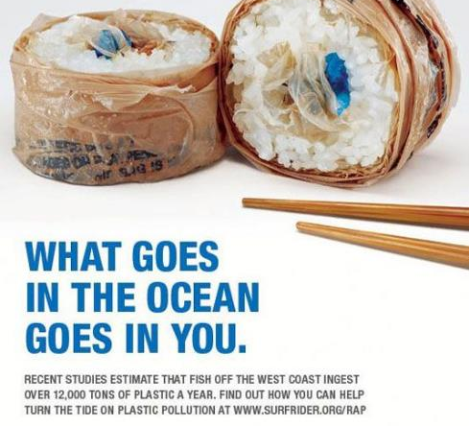
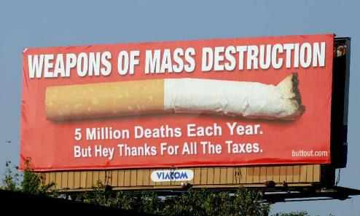

Slide 13
pathos
Appeals to the audience’s emotions and values
Appeals to EMOTIONS in the following ways:
Humor
Storytelling/Narration
Relatable Events/Experiences
Heart-Wrenching Examples
Mention of Feelings, Wants, Needs,
Desires, Fears, and Insecurities

Slide 14
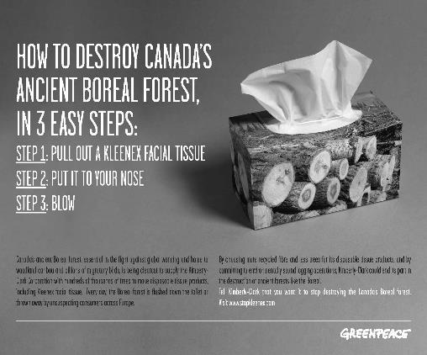
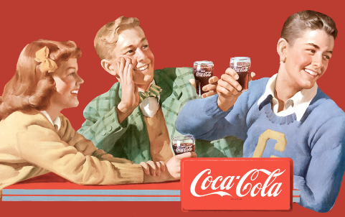

Slide 15
ethos
Appeals to the audience’s value of author’s credibility
An author can demonstrate CREDIBILITY by:
Showing Good Character
(trustworthy, likeable, honest, fair)
Showing Good Sense
(reliable, experienced, knowledgeable)
Showing Good Motives
(interest in what is best for audience, not self)

Slide 16
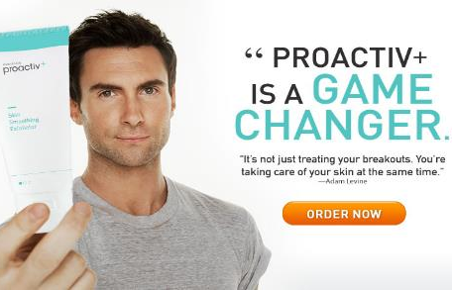
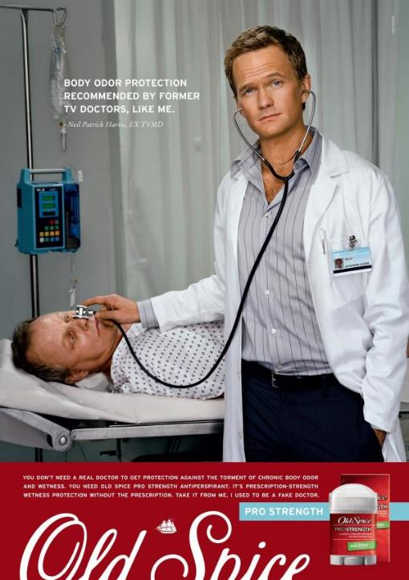
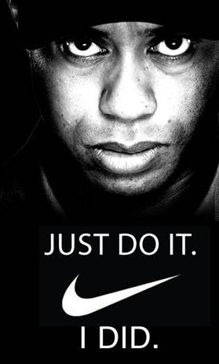

Slide 18
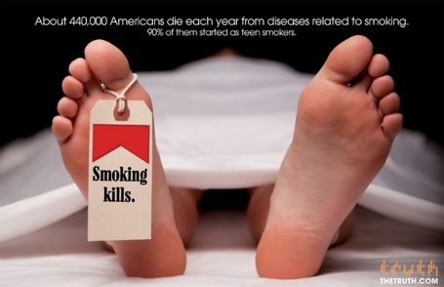

Slide 19
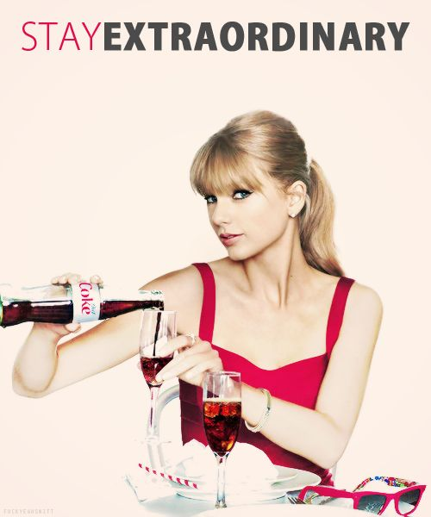

Slide 20
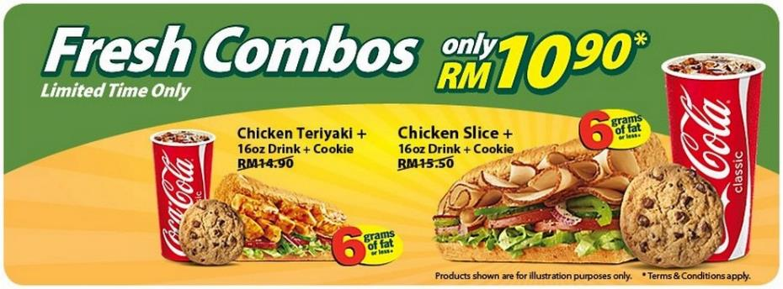

Slide 21
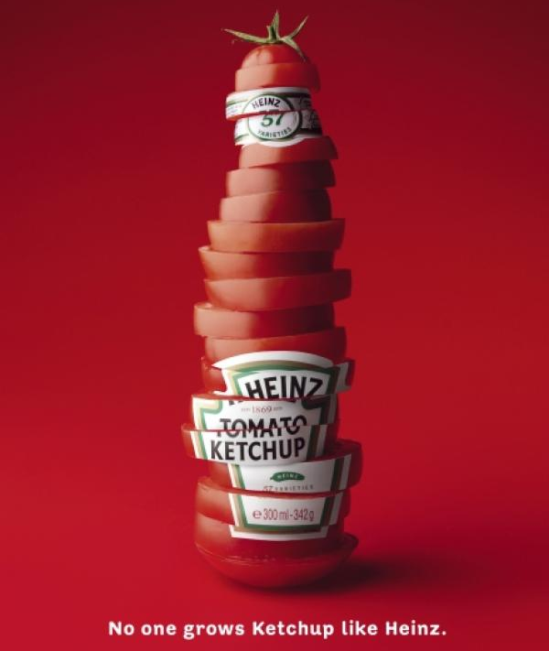

Slide 22
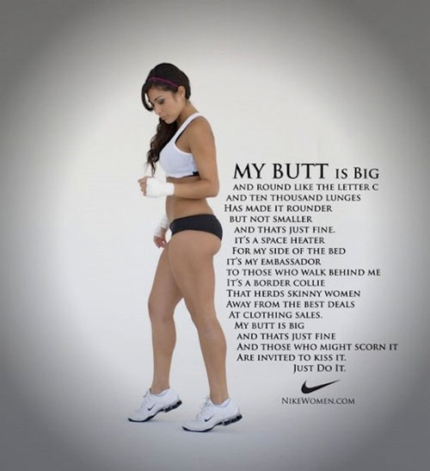

Slide 23
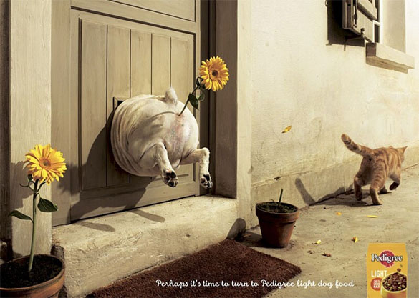

Slide 24
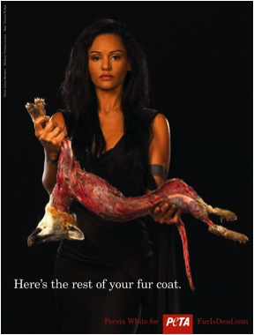

Slide 25
Ford: Go Further
Ethos, Pathos, Logos
in
Commercials
Honda: Yearbooks
T-Mobile: Martha & Snoop
Budweiser: Someone waits
Tropicana: Pure Premium

