Slide 1
The Writing Variables
Yes, even though they are called the WRITING variables, they are still applicable to you.

Slide 2
A Simple Guide Using Beyonce’s “Single Ladies” as an example

Slide 3
Form
The type of piece that is written or produced. Each form has a variety of different conventions that define it ☺
The form of “Single Ladies” is
A Song
Some other Examples include:
Letters, newspaper articles, films, commercials, paintings, movie trailers, etc.

Slide 4
Central Idea
This is the main idea that the piece is trying to express.
The central idea of “Single Ladies” is
If you like it, then you shoulda put a ring on it.
Some other Examples include:
“Don’t talk to strangers,” “Love conquers all,”

Slide 5
Purpose
The reason why a piece was written.
The purpose of “Single Ladies” is
To entertain and/or to instruct
Some other Examples include:
To inform, to inspire, to describe, to persuade, to evaluate, to reflect

Slide 6
Audience
The group of humans who you intend to present your piece to; the humans who will be viewing your piece.
The audience of “Single Ladies” is
Single Ladies, Teens-Young Adults
Some other Examples include:
Adults, teenagers, young women, crazy old cat ladies, mothers, etc.

Slide 7
Context
The situation in which you would be presenting your piece. This is not to be confused with form (how it looks, rather than where it is).
The context of “Single Ladies” is
YouTube, Ms. Hammond’s “Jay-Z & Beyonce” playlist the week before the “On the Run Tour”
Some other Examples include:
A classroom, a school bulletin board, a hockey game at intermission, a movie theatre during a special VIP showing

Slide 8
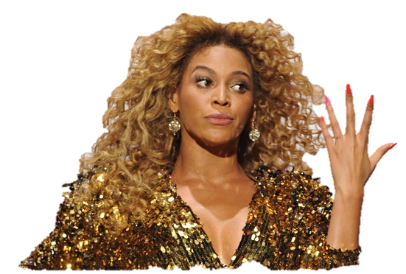
The Writing Variables
Are very important. You must always be sure to think long and hard about them before you begin planning your piece, since they affect its appearance, presentation, and content.

